Slide 1
MACHINE LEARNING
Final Project
by Carl Wilhjelm

Slide 2

Intro
Python
PyCharm
Pandas
Numpy
Scikit-learn

Slide 3
Part 1:
Classification

Slide 4
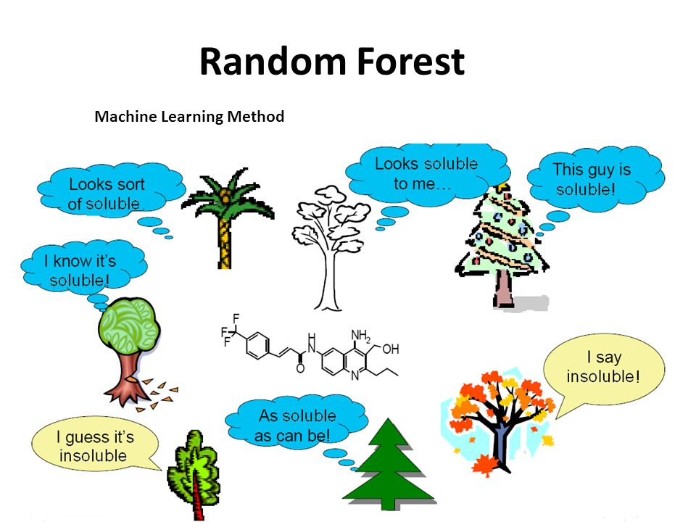
KNN
Random Forest
Missing Values?
Results?

Slide 5
Part 2:
Missing Value Estimation

Slide 6
1) given the row for the element which is missing and sought after, remove from all consideration the columns in this row which do not have values 2) search all other rows for ‘nan’ values and if the row contains a ‘nan’ value in any column which is being considered, remove this row from consideration for nearest neighbors 3) once all possible neighbors are found, sort by distance and calculate value of missing element using weights
Definitely works well probably

Slide 7
conclusion
Improvements?

